Slide 1
KineTrax
Team KineJax
Team Members: Anthony Black, Jack Jenkins,
Cherie Parsons, Grant Swenson, and Chris Whitney
Client/Sponsor: Kyle Winfree
1
Notes:
Chris

Slide 2
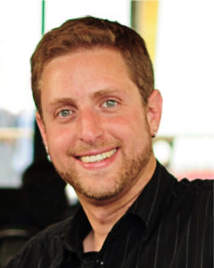
Mentor / Client
Faculty Mentor / Client
Kyle Winfree
  BS Physics
  MES Robotics
  PhD Biomechanics and Movement Science
Part of SICCS department at NAU
Interested in:
  Using wearable technology to measure and improve healthcare.
2
Notes:
Chris

Slide 3
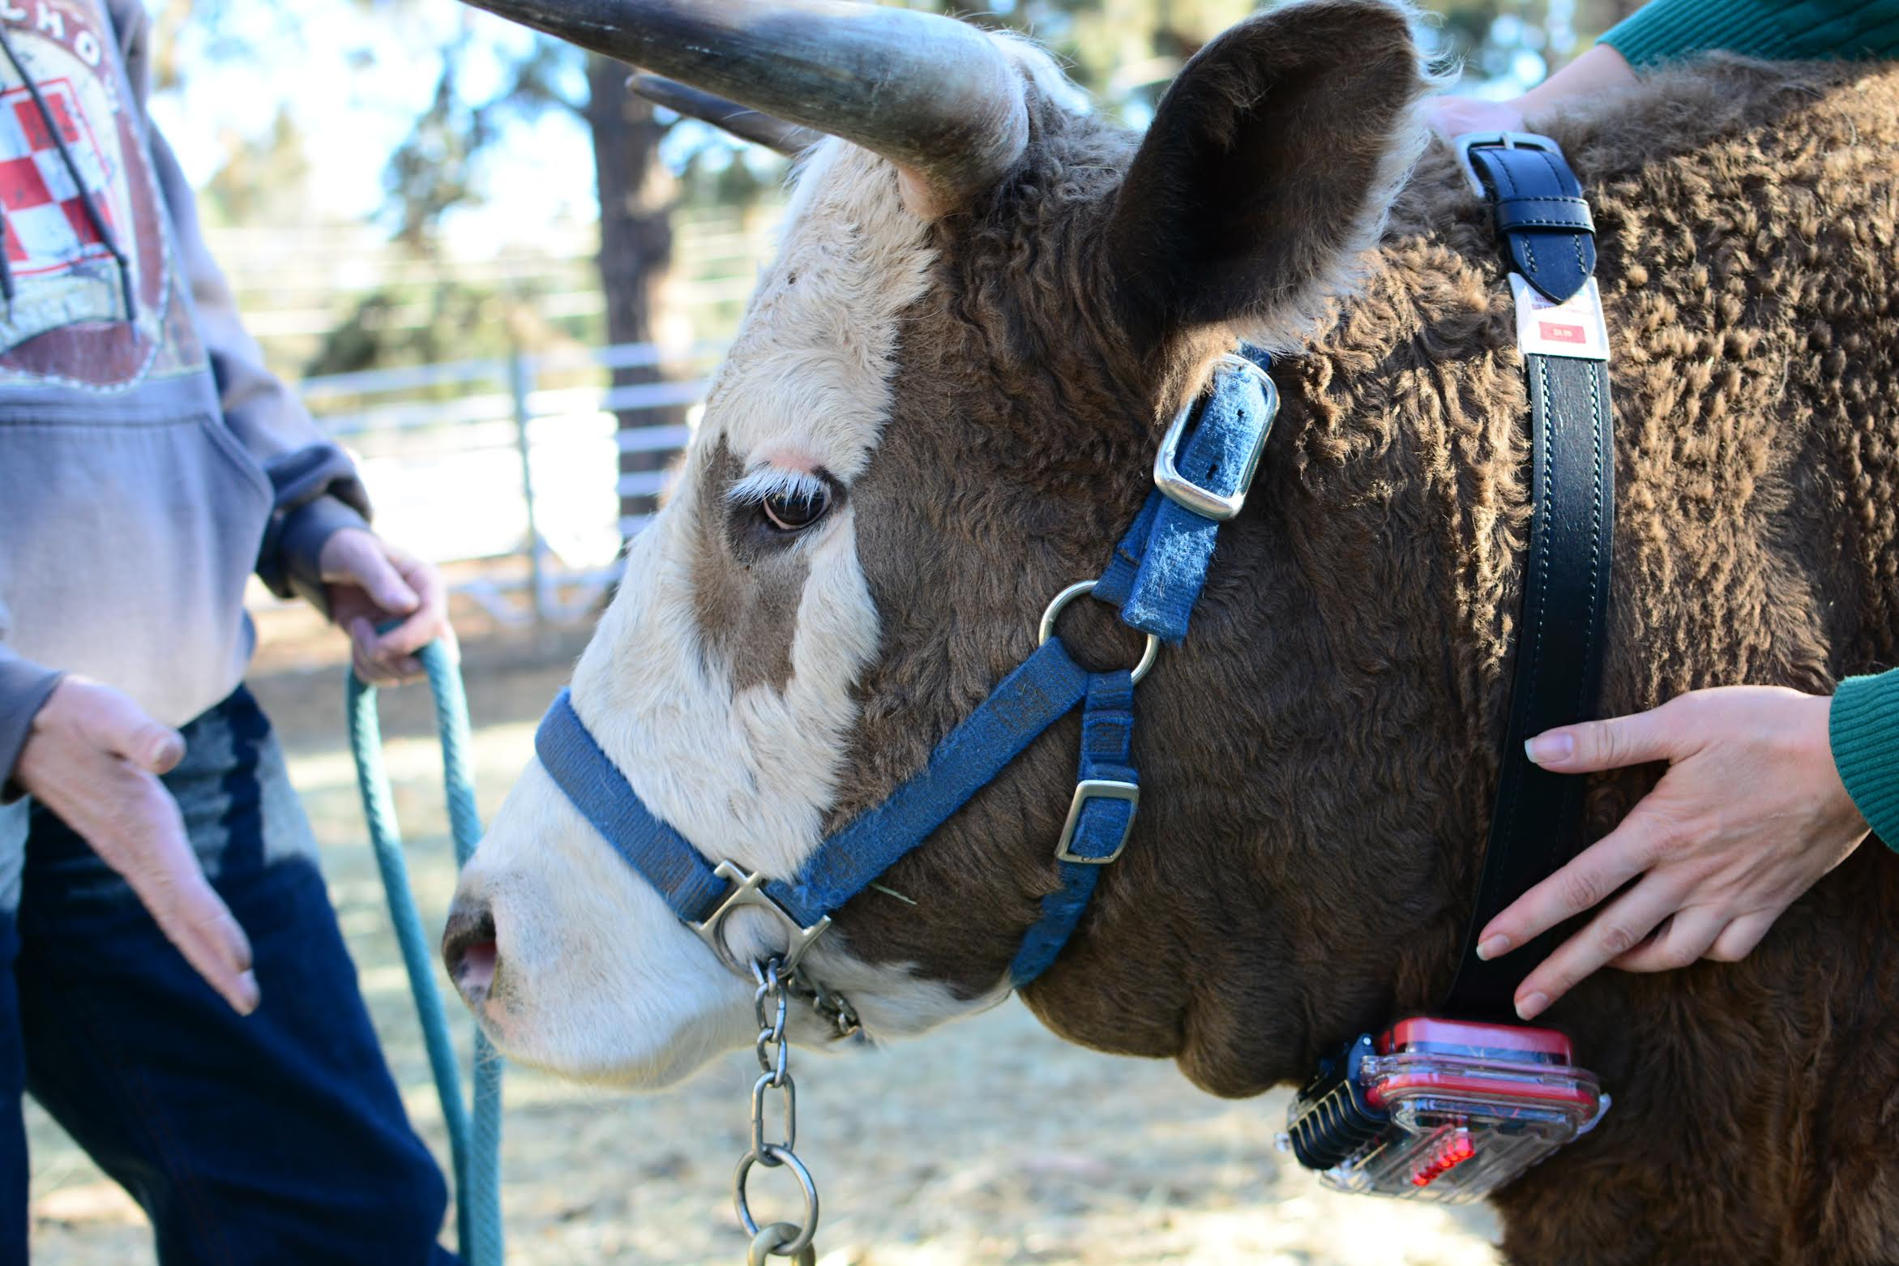
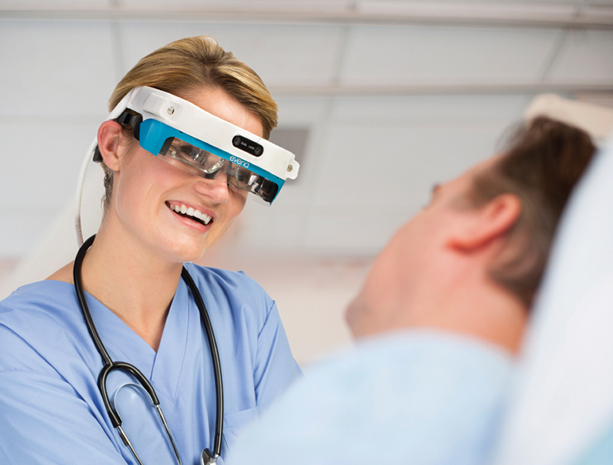
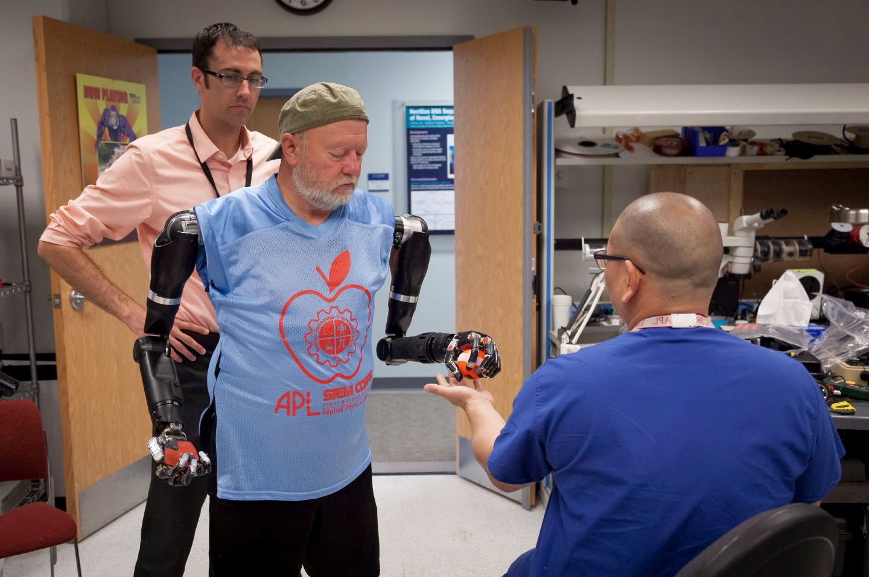
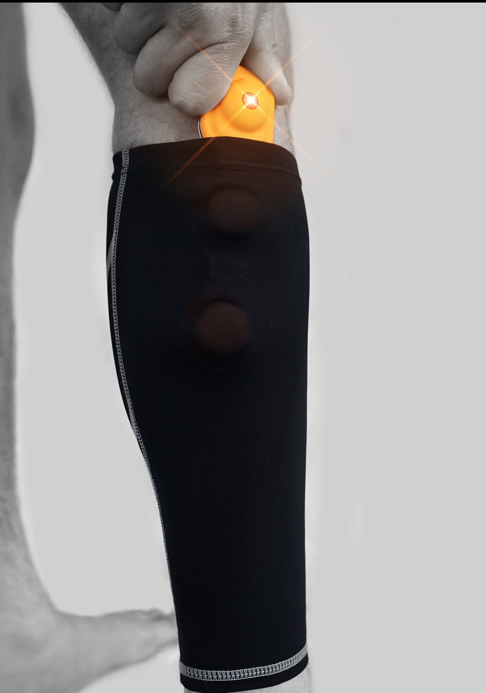
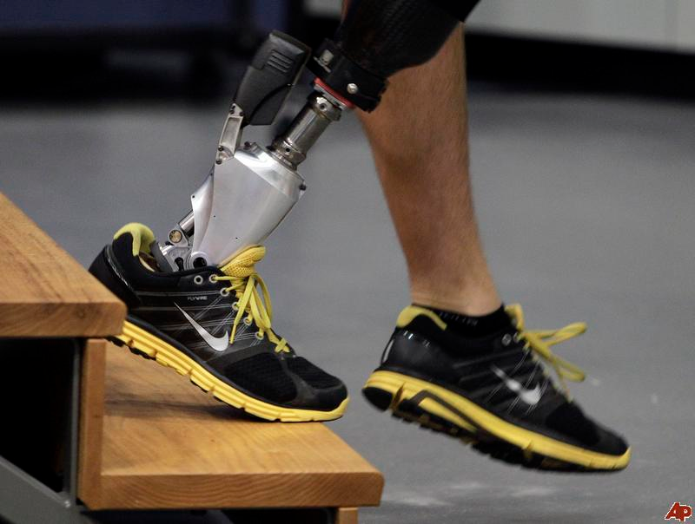
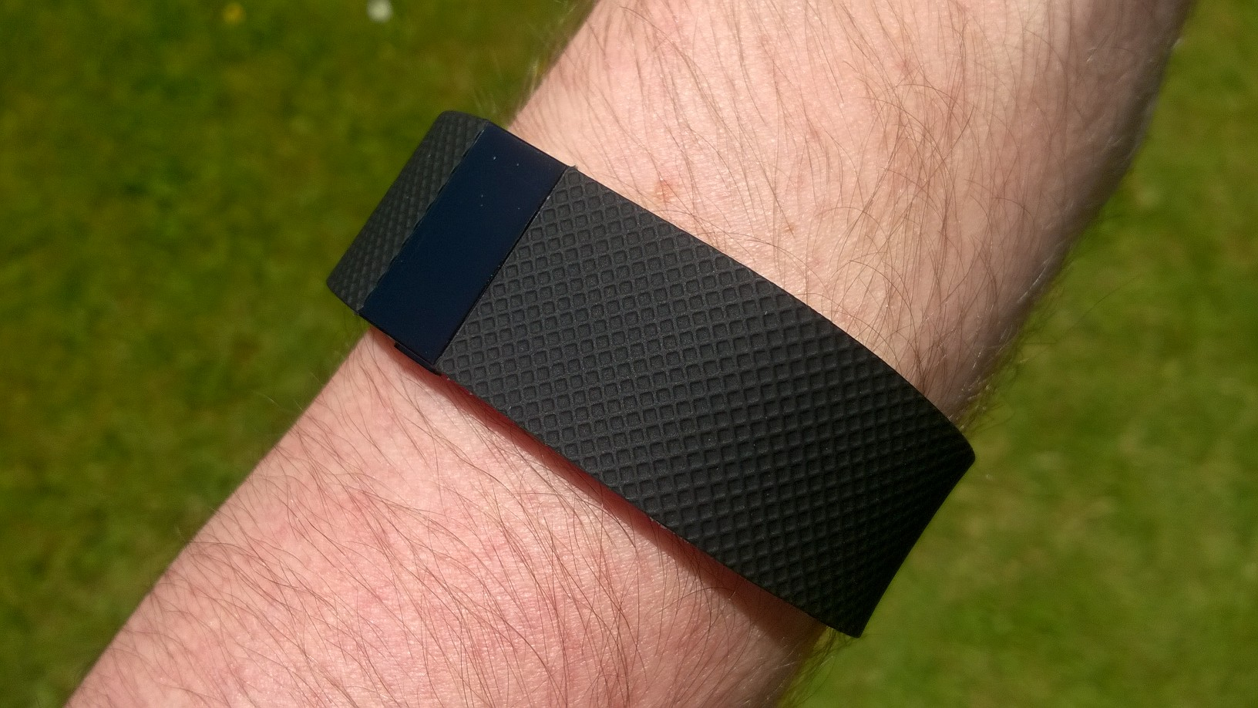
Background - Wearables
3
Notes:
Chris

Slide 4
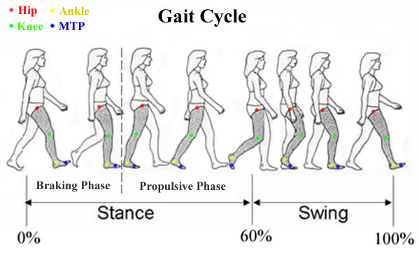
Background - Gait Analysis
4
Notes:
Chris

Slide 5
Problem Statement
Current wearable devices are unable to interface with other devices/sensors and are unable to give the necessary resolution for gait analysis in a community setting.
5
Notes:
Grant
Explain vicon system takes long to set up constrained to a room.
No external sensors for wearables.

Slide 6
Limitations
Current wearable devices:
Unable to interface with other devices
No synchronization across a distributed network
Doesn't yield the resolution of measurements as other capturing systems (i.e. Vicon)
 | Fitbit | ActiGraph | Vicon
Interface w/ devices
Sync
Resolution | 1 min | 30-100 Hz | 100+ Hz
Cost | Low | Expensive | Expensive
6
Notes:
Grant
put chart comparing fitbit,actigraph,vicon instead of wireless signal
compare resolution,synchronization interfacing w/ other devices

Slide 7
Why is this important?
Information technologies (i.e. data acquisition and storage) is rapidly growing, however, the technologies that sensor and record our movement are not keeping up. This data, if occured could help:
scientists ask interesting questions
doctors make more informed and appropriate treatment decisions
those with movement impairments live normal lives
7
Notes:
Grant

Slide 8
Solution Overview
8
Notes:
Grant

Slide 9
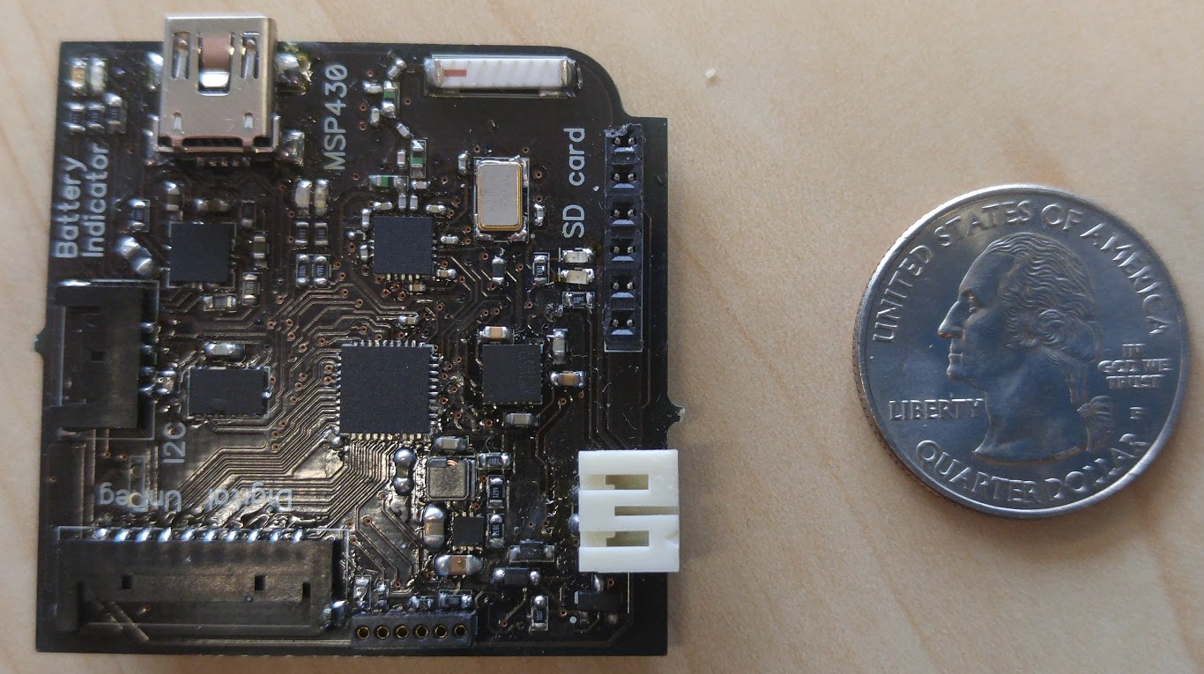
Solution - KineTrax
What the KineTrax offers:
Digital I/O ports
Analog I/O ports
I2C bus, allowing 127 sensors/peripherals
What does this mean?
Not limited to medical research
9
Notes:
Cherie

Slide 10
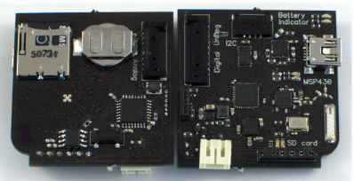
Key Components
Real-time clock
Digital and Analog I/O
USB Charger
SD CARD
Gyroscope / Accelerometer
Wireless
Microprocessors
Battery
10
Notes:
Cherie
Less texts, more figures/data (i.e. 32GB, Month, points worn on the body, 6-axis IMU, point to radio antenna, I2C supports 125 more sensors)
What are other kinds of I2C devices? (GPS)
More applications than just person wearable (i.e. cattle)

Slide 11
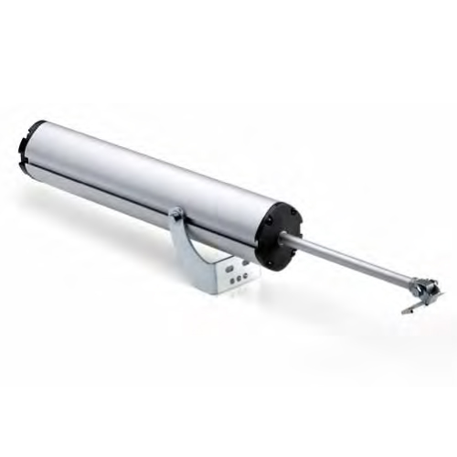
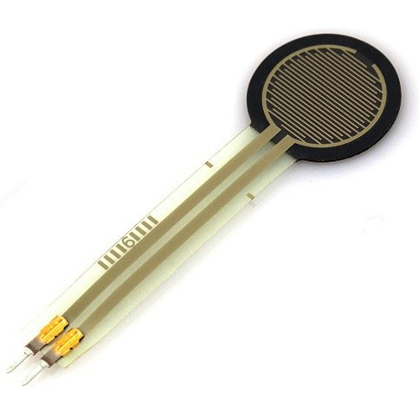
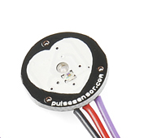
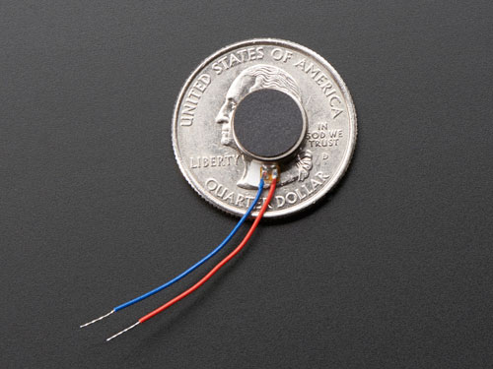
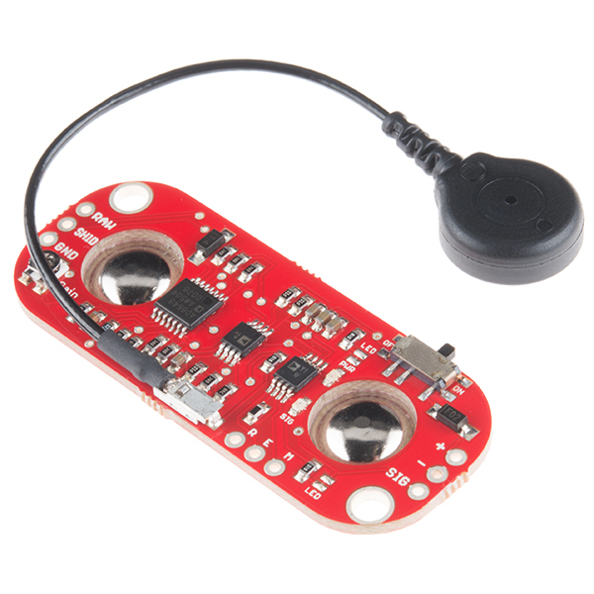
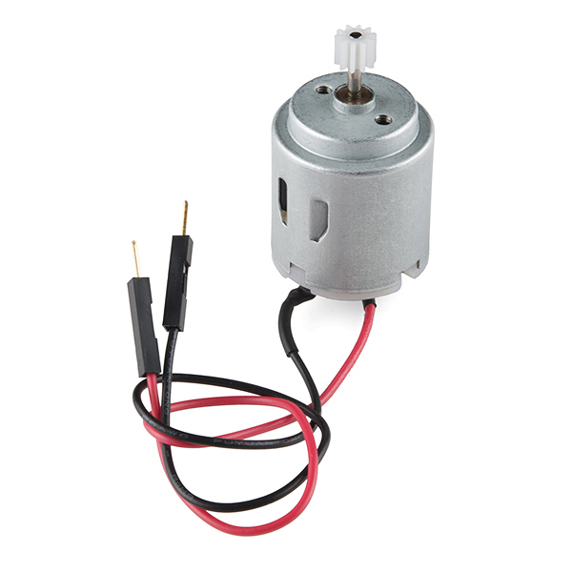
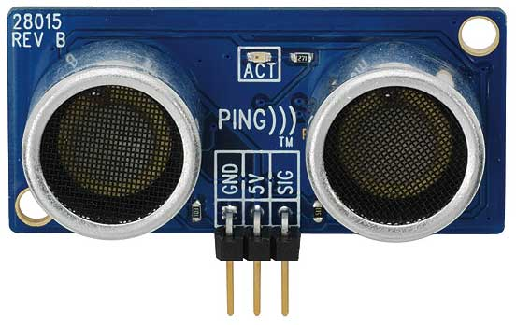
Examples of I/O Devices
Input (Sensors, etc.)
Output (Actuators, etc.)
11
Notes:
Cherie
Ultrasound
Force-sensitive resistor
Muscle-activation sensor
Heart-rate monitor
Actuators/motors
Vibration motor

Slide 12
Requirements Review
Key Requirements:
Record/offload timestamped gyroscopic & accelerometer data
GUI to configure peripherals
Wireless communication between devices
Time synchronization between devices
12
Notes:
Chris

Slide 13
Architecture Overview
13
Notes:
Chris

Slide 14
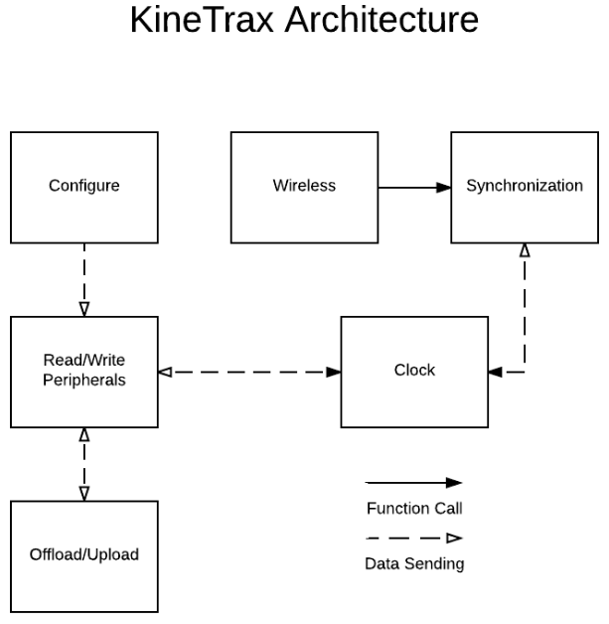
Implementation Overview(Embedded)
Offload/Upload
  Reads and writes data from SD card
  Communicates with connected PC
Configuration
  Sets peripheral addresses and sample rates
Peripherals
  Peripherals accessed through Inter-Integrated Circuit (I2C) and Universal Asynchronous Receiver/Transmitter (UART)
14
Notes:
Anthony
UART
I2C implemented through the URART
SD through OpenLog Protocol
Processor - Main Loop
SimpliciTI for Network
Network via RF 2.4 GHz
RTC on I2C
Serial (putc())

Slide 15
Implementation Overview(Embedded) (cont.)
Real-time Clock
  Timekeeping unit on the device
Wireless Communication
  Communicates with other Kinetrax devices in network
Synchronization
  Calculates offset between time from Real Time Clock and time received from wireless messages.
15
Notes:
Anthony
UART
I2C implemented through the URART
SD through OpenLog Protocol
Processor - Main Loop
SimpliciTI for Network
Network via RF 2.4 GHz
RTC on I2C
Serial (putc())

Slide 16
Implementation Overview(PC)
Offload Data from Device
  Reading data from device
  Raw data to CSV
Configuration
  Loading from configuration file
  Saving to configuration file
  Setting configuration on device
16
Notes:
Anthony

Slide 17
Prototype Video Demo
17
Notes:
Chris

Slide 18
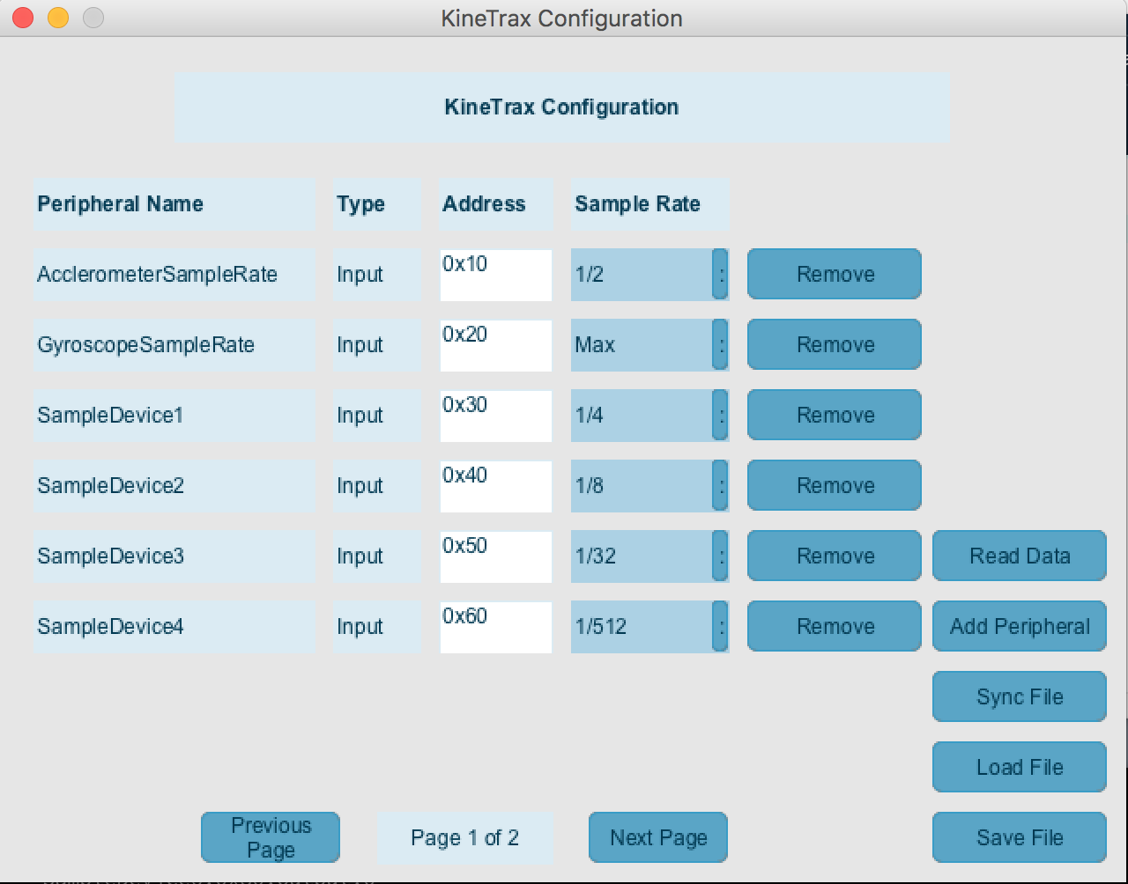
Prototype - Config GUI
18

Slide 19
Challenges and Resolutions
Big Challenges:
Debugging
Embedded systems
  Learning curve for embedded systems
  Acronyms (UART, I2C, SPI, etc.)
Hardware issues
  Sensor issues
  RTC and wireless can’t work simultaneously
Existing code has minimal documentation
Resolutions:
Research
  Existing documentation / sample code
  Embedded systems books
  Texas Instruments forums
External sensors
Hardware redesign
19
Notes:
Jack

Slide 20
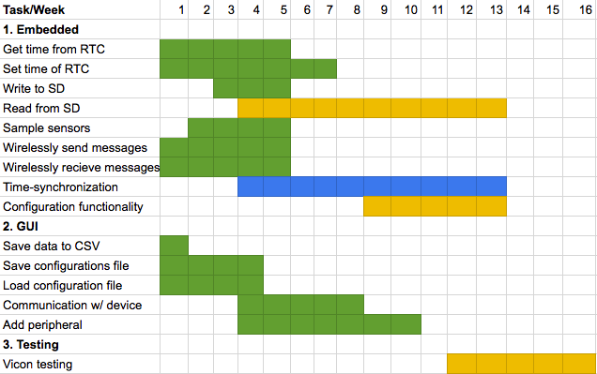

Schedule
20
Notes:
Jack

Slide 21
Testing Plan
Unit Testing
Wireless sending and receiving
Writing and reading from the SD
Setting and reading the real-time clock
Integration Testing
Vicon system at the Human Performance Lab
  Compare the accelerometer/gyro for different movements
Usability Testing
Testing GUI with 4 participants
21
Notes:
Jack

Slide 22
Conclusion
KineTrax has the potential to benefit lots of areas:
Movement impairments
Prosthetic limbs
Sports medicine
Farm animals
Lots of progress has been made:
Device can sample sensors
Device can get time from RTC
Device can wirelessly communicate
Writing samples to SD
GUI loads configuration file
GUI can save configuration file
22
Notes:
Chris

Slide 23
References
http://evenamed.com/eyes-on-glasses/
http://www.fabricatingandmetalworking.com/2015/02/waterjet-used-make-prosthetic-limb/Winfree
http://www.pcclassesonline.com/fitbit-charge-hr-vs-surge-review-and-tutorial/
http://www.operationward57.org/2011/03/new-bionic-prosthetic-for-lower-leg-amputees/
http://toughasia.com/blog/wearable-tech-vylyv-labs-smart-shorts-enable-men-to-strengthen-pelvic-floor-muscles/
https://www.amazon.com/Programming-Embedded-Systems-Development-Tools/dp/0596009836
https://www.pearsonhighered.com/program/Gajski-Specification-and-Design-of-Embedded-Systems/PGM30685.html
http://www.quintic.com/education/case_studies/Gait%20Analysis.html
https://electrosome.com/wp-content/uploads/2014/12/Force-Sensing-Resistor-0.5.jpg

Slide 24
